Slide 1
Venue Location Analysis of Singapore
By Lars Mueller

Slide 2
Problem Statement
What does the venue distribution in Singapore look like?
Which areas have the most coffee shops, Japanese restaurants, parks, bubble tea shops, and scenic lookouts?
Can this be confirmed through clustering?

Slide 3
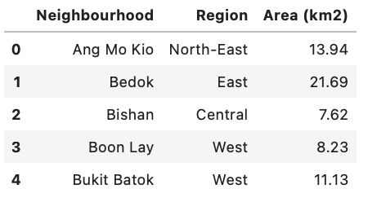
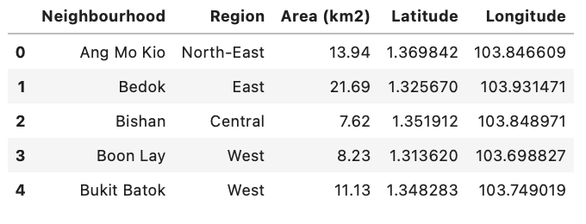
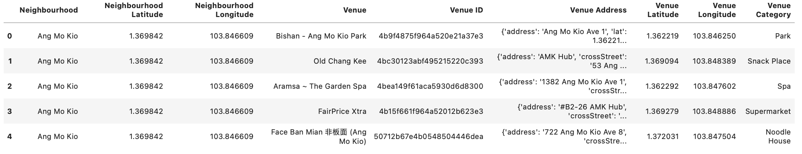
Data Sources
1. Scraping Wikipedia for the neighbourhoods in Singapore
2. Geocoding to get coordinates for each neighbourhood
3. Foursquare API to retrieve venues within a 2.5km radius of each neighbourhood
100 most popular and recommended venues in each neighbourhood
1.
2.
3.

Slide 4
Methodology
Retrieve required data using the previously shown data sources
Get most common venues in each neighbourhood
For all venue categories
For specified venue categories
Perform K-Means and DBSCAN clustering
Visualise clusters using Folium
Create and visualise groupings of venues using Folium to supplement clustering results

Slide 5
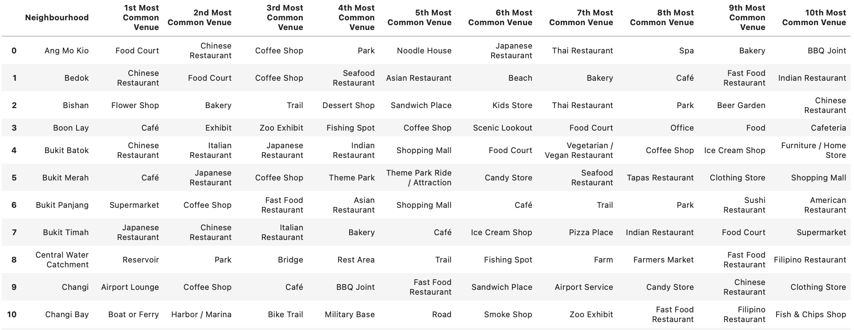
10 Most Common Venue Categories by Neighbourhood

Slide 6
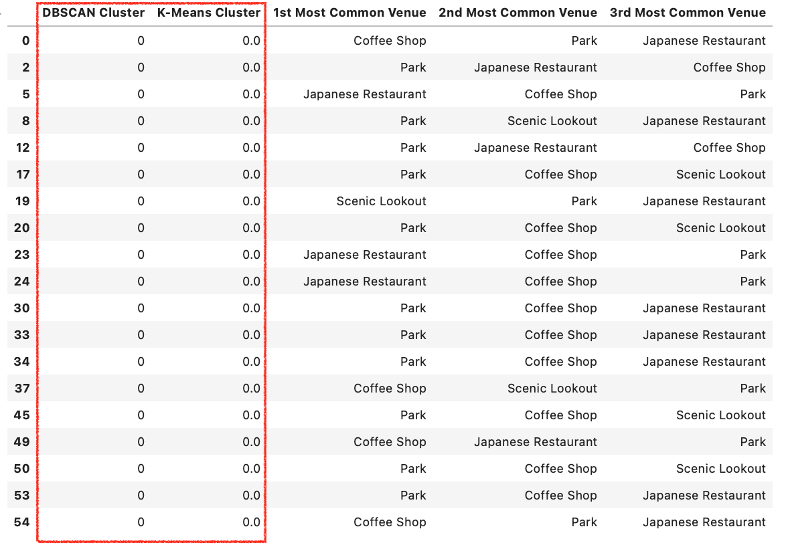
K-Means vs DBSCAN Cluster 0

Slide 7
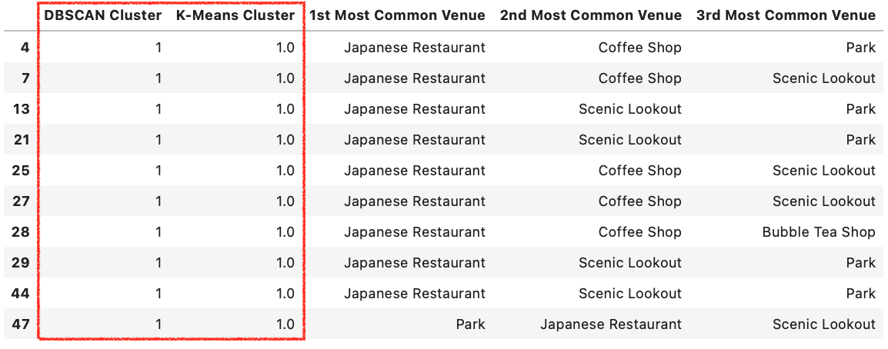
K-Means vs DBSCAN Cluster 1

Slide 8
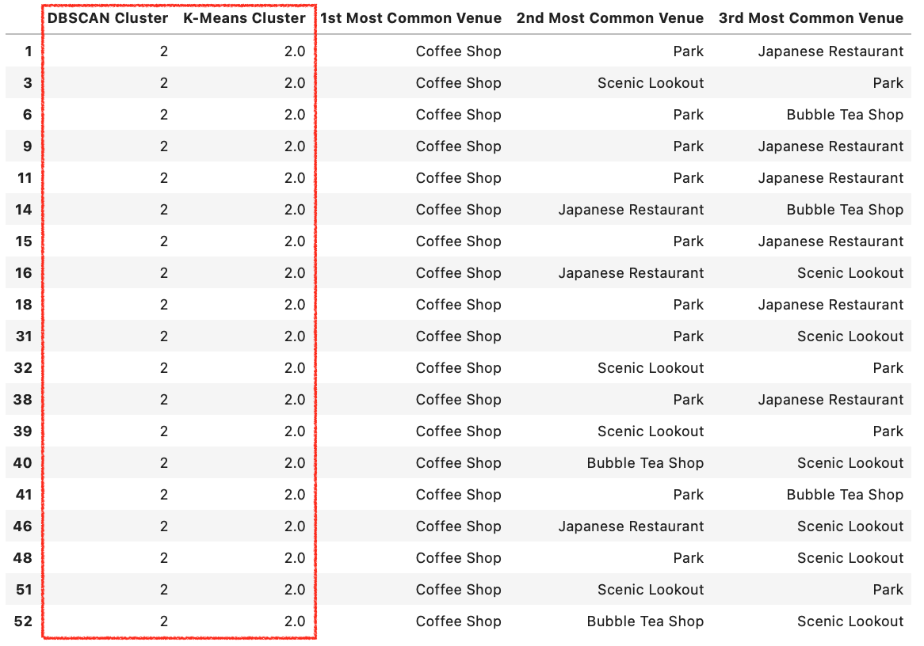
K-Means vs DBSCAN Cluster 2

Slide 9
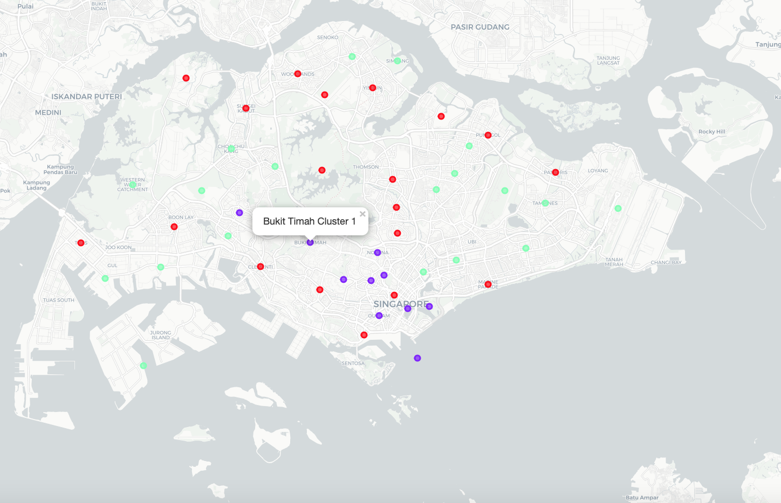
Cluster Map
Red: Predominantly Parks
Purple: Predominantly Japanese Restaurants
Green: Predominantly Coffee Shops

Slide 10
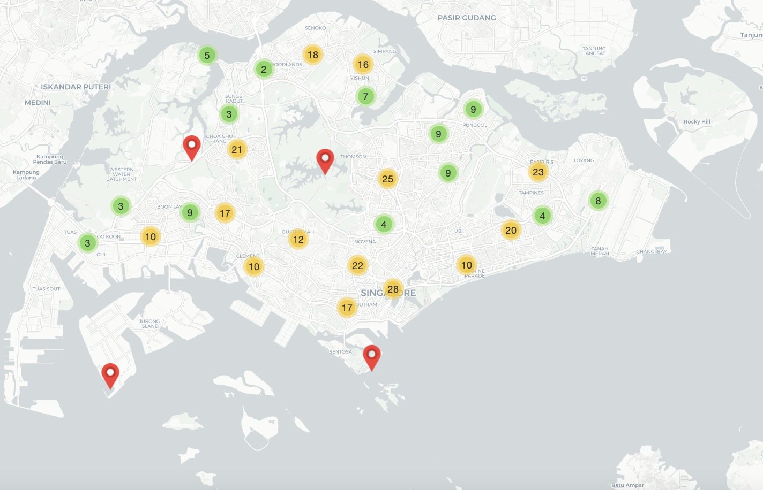
Interactive Folium Grouping Map to Supplement Clustering

Slide 11
Conclusion
In this project, the required data was extracted from the internet and the Foursquare API. The data was then wrangled and formatted into Pandas data frames. The processed data was clustered using two unsupervised machine learning algorithms to give further insights into where certain venues are situated across Singapore. The data was visualised using several tools throughout the project to provide a better understanding of the data.
It can be concluded that there are neighbourhoods which are better than others for visiting as many of the specified venue categories as possible to write a travel blog.

Slide 12
Thank you!

